Slide 1

Distributed Systems
Overview
CPSC 5520
Kevin Lundeen

Slide 2
Technology Advances Enable and Motivate Distributed Systems
Slides adapted from Dr. Yingwu Zhu

Slide 3
Technology Advances
Networking
Processors
Memory
Storage
Protocols

Slide 4
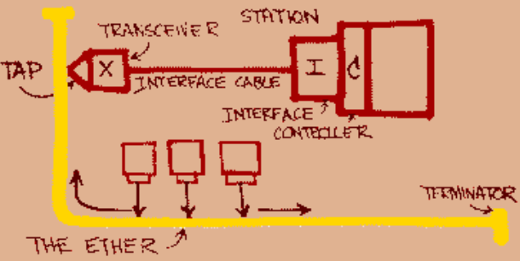
Networking: Ethernet − 1973, 1976
June 1976: Robert Metcalfe presented the concept of Ethernet at the National Computer Conference
1980: Ethernet introduced as de facto standard (DEC, Intel, Xerox)

Slide 5
Network Architecture
LAN speed
  Original Ethernet: 2.94 Mbps
  1985: thick Ethernet: 10 Mbps
  1991: 10BaseT – twisted pair: 10 Mbps – switched networking: scalable bandwidth
  1995: 100 Mbps Ethernet
  2001: 10 Gbps introduced
  2005 – 2018: 40/100 Gbps
  Now: “Terabit” Ethernet 800 Gbps
Wireless LAN
  1999: 802.11b (wireless Ethernet) standardized
  2014: 802.11ac = 8 × 866.7 Mbps = 7 Gbps
  2020: 802.11ax claim 11 Gbps (theoretical 14 Gbps)
Personal Area Networks (PAN): Bluetooth, ZigBee, Z-Wave

Slide 6
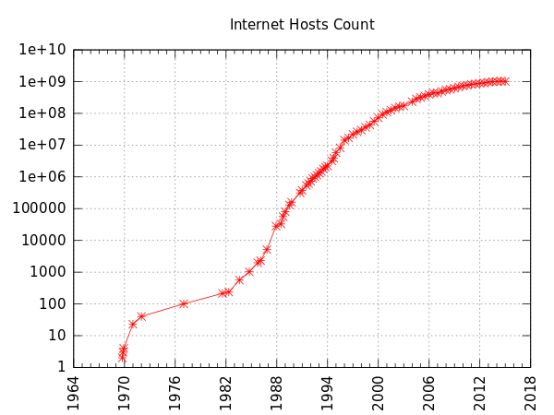
Network Connectivity
Then
  Large companies and universities on Internet
  Gateways between other networks
  Consumers used dial-up bulletin board
  1985: 1,961 hosts on Internet
Now
  One Internet (mostly)
  Over a billion hosts
  Widespread connectivity
  High-speed WAN connectivity:
  > 50 Mbps … 1 Gbps
  Switched LANs
  Wireless networking
  Mobile networking (5G up to 20 Gbps)

Slide 7






Metcalfe’s Law
“The value of a telecommunications network is proportional to the square of the number of connected users of the system (n²)”
This makes networking interesting to us!

Slide 8
Computing Power
Computers got
  Smaller
  Cheaper
  Power efficient
  Faster
  Microprocessors became technology leaders

Slide 9
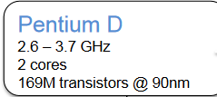
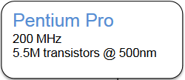
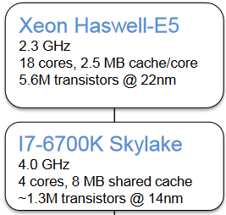
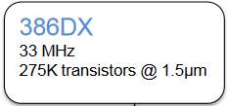
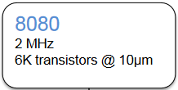
Computer Power (Processors)
1985 – now
− 714x smaller transistors
− > 7000x more transistors
− > 120x faster clock
We can no longer make CPUs much faster.
How do we get increased performance? More cores.
→ parallel system on a chip

Slide 10
Network Content: Music
Example: 9,839 songs
  49GB, Avg. = 5.2 MB/song
Today
  Streaming (Pandora/Spotify): 96 – 320 kbps
  Download time per song @ 100 Mbps: ~ 0.4 seconds
  Storage cost for this collection: ~ $1 ($100 for a 4 TB drive)
~ 40 years ago (1985)
  Streaming
  Download time per song, V90 modem @ 44 kbps: 15 minutes
  Storage cost: $511, 640 (40 MB at $400 – over 1,279 drives!)

Slide 11
Network Content: Video
Today
  Netflix streaming 4K video @ 15.6 Mbps (HEVC/h.265 codec)
  YouTube: stores ~ 76 PB (76×10¹⁵) per year
~ 40 years ago (1985)
  Streaming

Slide 12
Network Protocols
Many have been developed
  →APIs for network communication
Faster CPU
  Affordable for protocol processing
  ECC, TCP checksums, parsing
  Image and video compression feasible
Faster network
  → support bigger (and bloated) protocols
  E.g., SOAP/XML, JSON – Human readable, explicit typing

Slide 13
Why build distributed systems?

Slide 14
What is a Distributed System?
A collection of independent, autonomous hosts connected through a communication network working together to perform a service
  No shared memory
    must use the network
  No shared clock
    a root cause for complexity of distributed systems

Slide 15
Architecture Evolution
Single System Image
  Collection of independent computers that appears as a single system to the user(s)
    Independent = autonomous
    Single system: users are not aware of distribution
Multiprocessors
  Shared memory
  Shared clock
  All-or-nothing failure
Multicomputers
  No shared memory
  No shared clock
  Partial failures
  Inter-computer communication: network
    Traffic much lower (and slower) than memory access

Slide 16
We Want …
Scale
High availability
Fault tolerance
Reduced latency
Delegated operations
Collaboration
Mobility
Incremental cost

Slide 17
Scale: Increased Performance
Computers are getting faster
Moore’s Law
  “The number of transistors in an integrated circuit doubles approximately every two years.”
  Commonly described as performance doubling every 18 months because of faster transistors and more transistors per chip
Not a real law: – just an observation from the 1970s

Slide 18
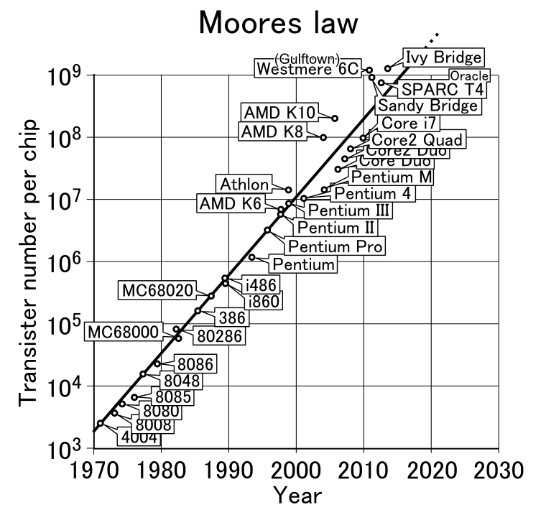
https://commons.wikimedia.org/wiki/File:Moores_law_(1970-2011).PNG

Slide 19
We want…
Scale
Getting harder for technology to keep up with Moore's law
  More cores per chip → requires multithreaded programming
  There are limits
    Intel Xeon CPU Max 9480: 56 cores per chip (>$10,000/chip!)
    NVIDIA GeForce RTX4090: 16,384 CUDA cores per chip
      Special purpose apps: Graphics rendering, neural networks
We want to build systems that can process billions of requests per day
  Google gets over 40,000 queries per second
  Facebook:
    >2 billion searches per day; 13 million database queries per second
We also want access to exabytes (10¹⁸) of storage

Slide 20
How to get massive performance?
Multiprocessor systems don’t scale!
Example: movie rendering
  Toy Story 3: average frame takes 7 hours to render
    Some can take 39 hours
  Monsters University: an average of 29 hours per frame
    2,000 computers with 12,500 cores
    Total time: over 100 million CPU hours
    3, 000 to over 5,000 AMD processors; 10 Gbps and 1 Gbps networks
  Disney's Frozen
    30,000 core renderfarm – 60M render hours – 5 PB storage
Google
  Over 40,000 search queries per second on average
  Index >50 billion web pages
  Uses hundreds of thousands of servers to do this

Slide 21
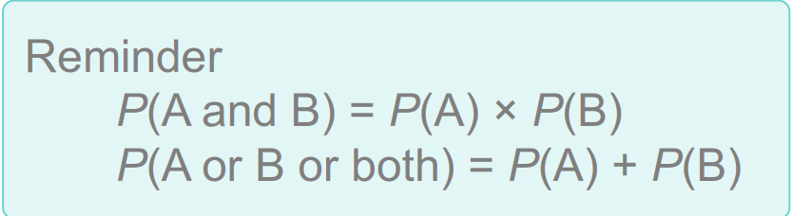
We want…
High Availability
Redundancy = replicated components
  Service can run even if some systems fail
  If P(any one system down) = 5%
  P(2 systems down at the same time) = 5%×5% = 0.25%
  BUT if we need all systems up to provide a
  service P(any system down) ≈ 10% !

Slide 22
We want…
Fault Tolerance
Availability Requires Fault Tolerance
Fault tolerance
  Identify & recover from component failures
Recoverability
  Software can restart and function
  May involve restoring state

Slide 23
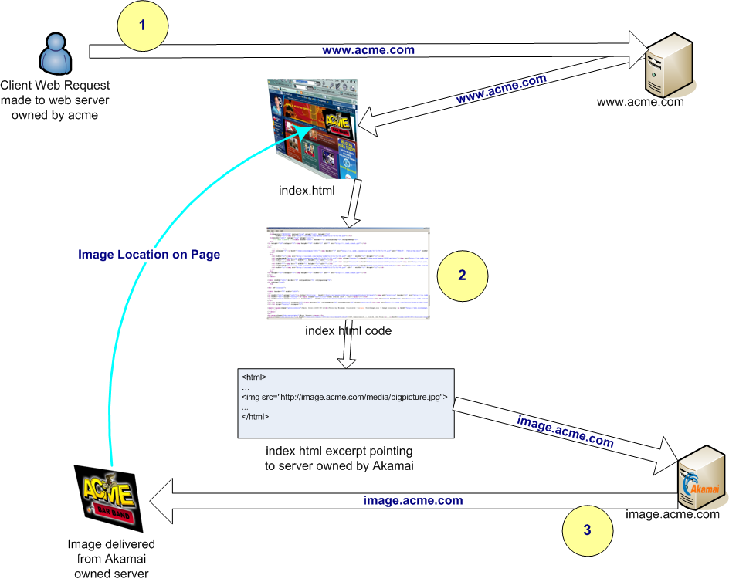
We want…
Reduced Latency
Replication across geographies
Cache data close to where it is needed
Example: Akamai
By Kim Meyrick - http://en.wikipedia.org/wiki/Image:Akamaiprocess.png, CC BY 3.0, https://commons.wikimedia.org/w/index.php?curid=2693411

Slide 24
We want…
Delegated Operations
Offload responsibility
  Let someone else manage systems
  Use third-party services
Modularize services on different systems
  Dedicated systems for storage, email, etc.
Cloud, network attached storage (NAS)

Slide 25

We want…
Collaboration
Content!
Collaborative work & play
Social connectivity
Commerce
News & media

Slide 26
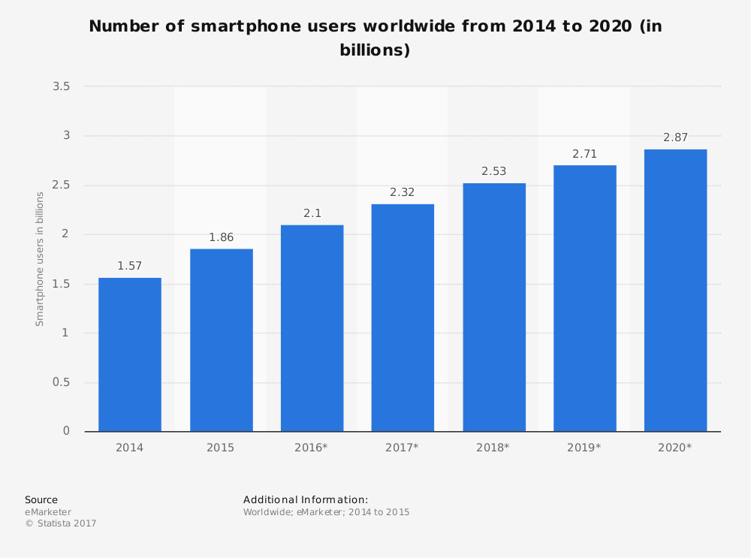
We want…
Mobility
Over 6 billion smartphones
Remote sensors
  Cars
  Traffic cameras
  Toll collection
  Shipping containers
  Soda machines
IoT = Internet of Things

Slide 27
We want…
Incremental cost
Scale also implies cost
Facebook
  Started on one rented server at $85/month
Google
  Original storage in 1996: 10 4GB drives = 40 GB total
  1998 hardware
    Sun Ultra II, 2 Intel dual-Pentium II servers, quad-processor IBM RS/6000
    ~ 475 GB of disks

Slide 28

More to come…

